Slide 1
Introduction To Web Development
Meghana P

Slide 2
Introduction to Web Development
Web development refers to the process of creating, building, and maintaining websites or web applications that are accessible on the internet. It encompasses a range of tasks and activities, including web design, web content development, client-side and server-side scripting, database management, and web server configuration.
Web developers use various programming languages, frameworks, and tools to create interactive and functional websites that can serve a wide range of purposes, from informational websites and blogs to e-commerce platforms, social media networks, and web-based applications.
Web development is a multidisciplinary field that involves both front-end development, back-end development and database management

Slide 3
Importance in the digital age
Web development is of paramount importance in the digital age for several reasons:
Global Accessibility: The internet has become an integral part of daily life for billions of people worldwide. Web development enables businesses, organizations, and individuals to reach a global audience, making information, products, and services accessible to a vast and diverse population.
Business Presence: A well-developed website is often the first point of contact between a business and its potential customers. It serves as a digital storefront, creating a lasting impression and influencing consumers' perception of a brand.
E-commerce: The growth of e-commerce has revolutionized the way people shop. Web development plays a critical role in creating and maintaining online stores, allowing businesses to sell products and services to customers 24/7, without geographical limitations.

Slide 4
Importance in the digital age
Content Sharing and Information Dissemination: Websites are essential platforms for sharing information, news, educational content, and more. Web development enables the creation of blogs, news portals, educational websites, and knowledge-sharing platforms.
Communication and Social Interaction: Social media networks, messaging apps, and other communication platforms heavily rely on web development. They facilitate real-time communication, collaboration, and networking among individuals and groups.
Automation and Efficiency: Web applications and back-end development automate numerous tasks and processes, increasing efficiency and productivity across various industries. This includes areas like customer relationship management (CRM), inventory management, and data analysis.

Slide 5
Key Technologies Of Web Development
Web development relies on a variety of key technologies and tools to create, design, and maintain websites and web applications. These technologies span multiple layers of the web development stack, including front-end, back-end, and databases. Here are some of the essential technologies used in web development:
Front-End Technologies:
HTML (Hypertext Markup Language)
CSS (Cascading Style Sheets)
JavaScript
Front-End Frameworks
Responsive Web Design
Web Accessibility (A11y)

Slide 6
Key Technologies Of Web Development
Back-End Technologies:
Web Frameworks
Databases
APIs (Application Programming Interfaces)
Server Management and Deployment
Authentication and Security

Slide 7
Key Technologies Of Web Development
Other Key Technologies
Package Managers:
Task Runners and Build Tools
Content Management Systems (CMS)
Web Servers
Testing and Quality Assurance Tools
Performance Optimization

Slide 8
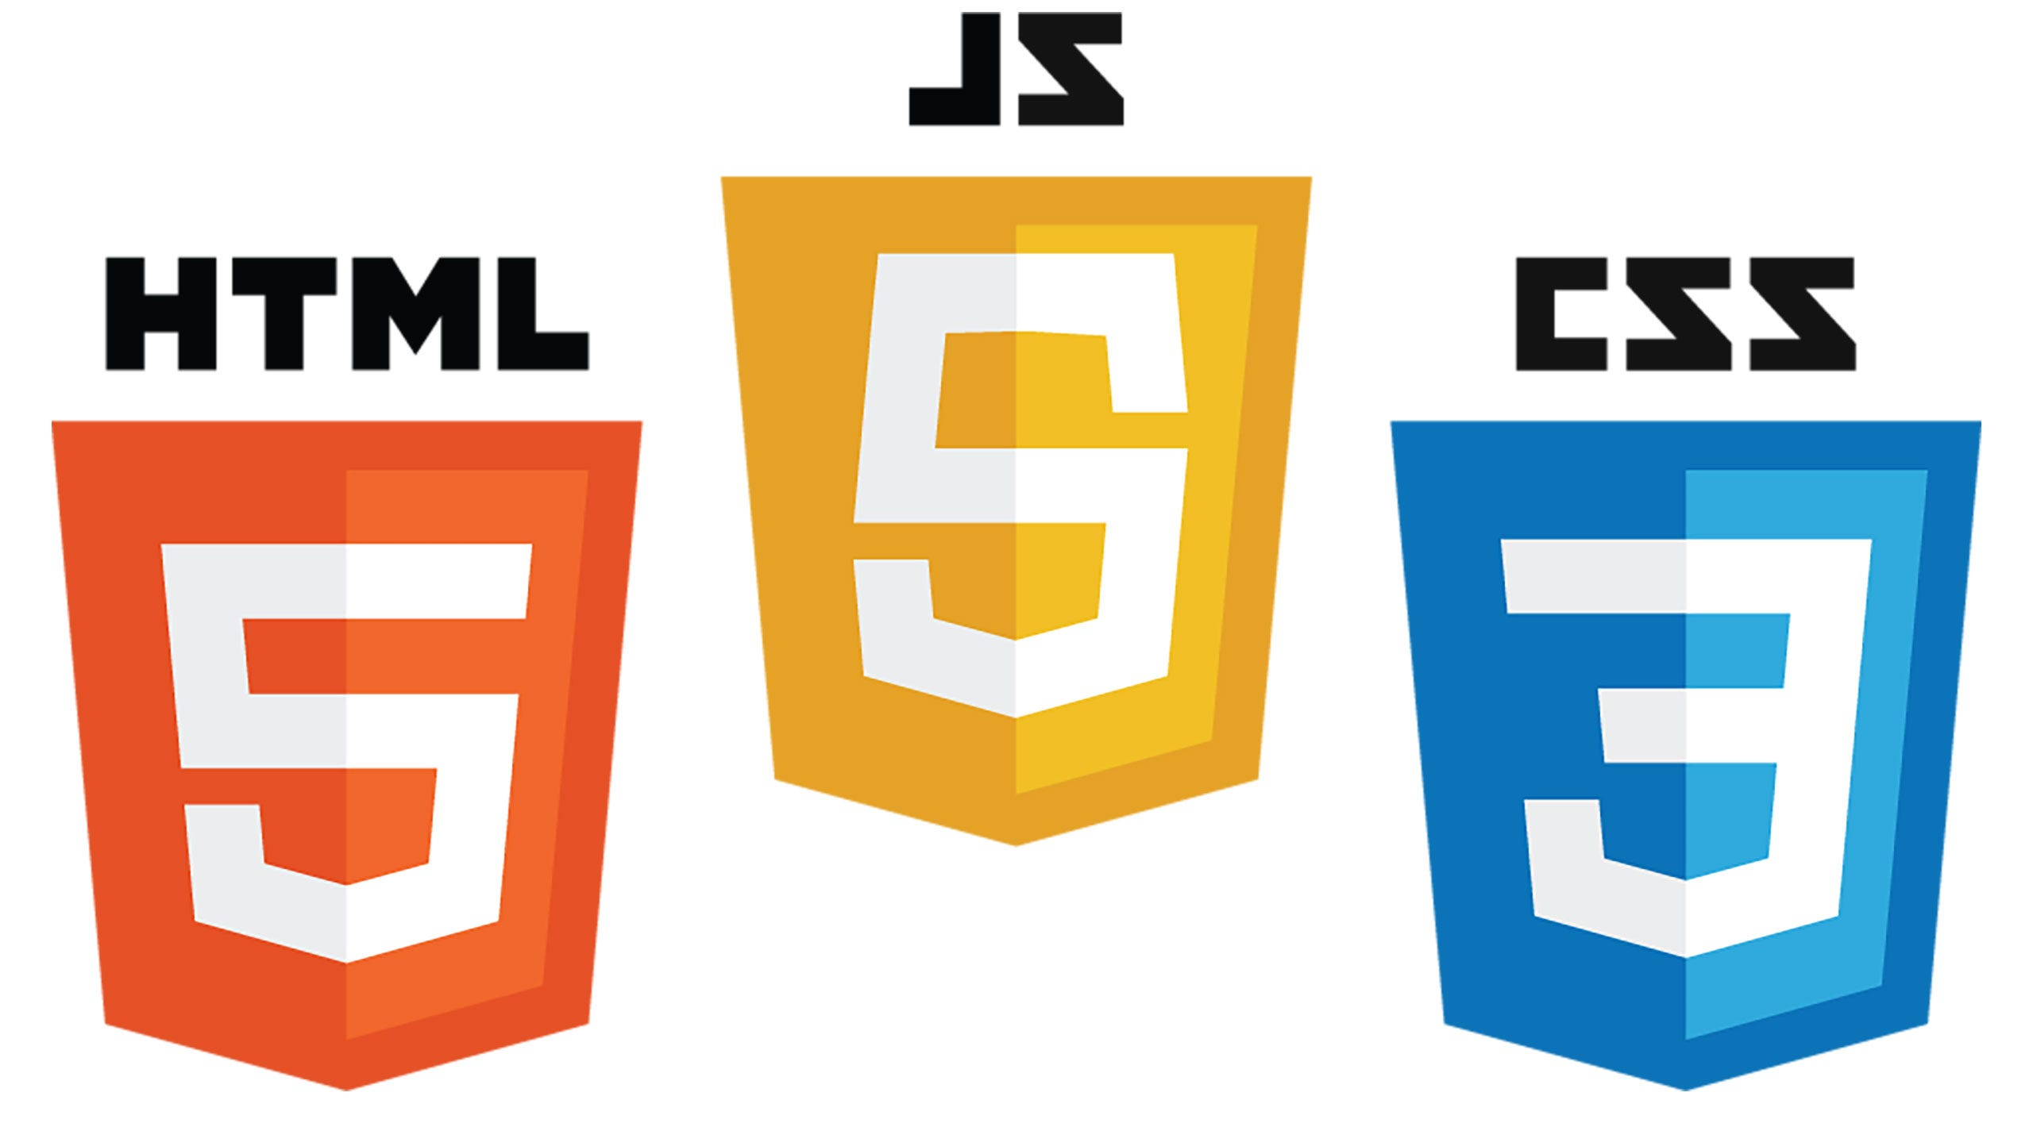
Front-end Development
Front-end development is the process of designing and implementing the user interface of a website or web application. It involves creating the layout, visual design, and interactive elements that users see and interact with when they visit a website.

Slide 9
HTML
Role of HTML (Hypertext Markup Language): HTML is the backbone of front-end development. It provides the structure and content of a web page. Here's how HTML contributes to front-end development:
Structure: HTML defines the structure of a web page by using elements like headings, paragraphs, lists, and tables. It outlines the hierarchy of content on a page.
Semantic Markup: HTML offers semantic elements (e.g., <header>, <nav>, <footer>) that give meaning to different sections of a web page. This helps search engines and accessibility tools understand the content.
Links and Media: HTML allows you to create hyperlinks to other pages and embed multimedia elements like images, audio, and video

Slide 10
CSS
Role of CSS (Cascading Style Sheets): CSS is responsible for the presentation and styling of a web page. It enhances the visual appeal of HTML content. Here's how CSS contributes to front-end development:
Visual Styling: CSS is used to define colors, fonts, spacing, borders, backgrounds, and other visual properties to make the web page visually appealing.
Layout Control: CSS can control the layout of elements, including their positioning, alignment, and responsiveness. It enables the creation of responsive designs for different screen sizes.
Animations and Transitions: CSS can add animations and transitions to elements, making the user interface more interactive and engaging.

Slide 11
JavaScript
Role of JavaScript: JavaScript is a powerful programming language that adds interactivity and dynamic behavior to web pages. Here's how JavaScript contributes to front-end development:
Interactivity: JavaScript allows you to create interactive features such as form validation, sliders, interactive maps, and real-time updates without requiring a page refresh.
DOM Manipulation: JavaScript can manipulate the Document Object Model (DOM), which represents the structure of a web page. This enables dynamic content updates and interaction with HTML and CSS.
Event Handling: JavaScript handles user interactions, such as clicks, mouse movements, and keyboard inputs, and responds to them by executing specific code.
AJAX (Asynchronous JavaScript and XML): JavaScript can make asynchronous requests to the server to fetch data without reloading the entire page, facilitating a smoother user experience.

Slide 12
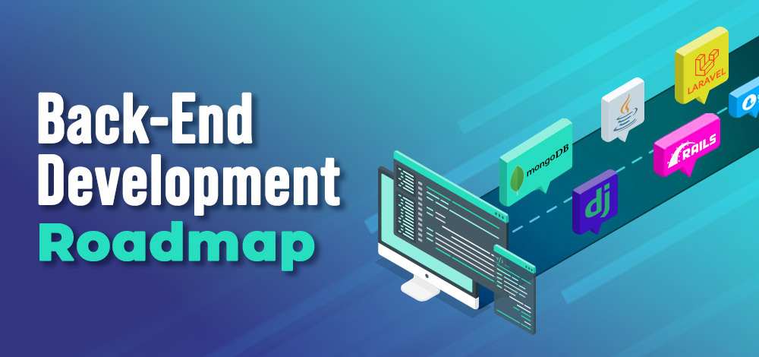
Back-End Development
Back-end development involves working with the server-side of a web application, which includes the server, databases, and the server-side scripting code. The primary objectives of back-end development are data management, server-side logic, and ensuring the overall functionality of the web application. Back-end developers work to provide data and services to the front-end, enabling dynamic and interactive experiences for users.

Slide 13
Back-End Development
Server-Side Scripting Languages : Server-side scripting languages are programming languages used to write the logic and functionality that runs on the server. Here's how server-side scripting languages contribute to back-end development:
Handling Requests and Responses: These languages are responsible for receiving HTTP requests from clients (usually web browsers), processing these requests, and sending back appropriate responses. This includes handling user registrations, logins, and any other interactions with the server.
Business Logic: Server-side scripting languages execute the business logic of the application. This includes calculations, data validation, user authentication, and more. The code ensures that the application functions correctly and securely.

Slide 14
Back-End Development
Integration with Databases: Back-end languages are used to interact with databases to store, retrieve, and manipulate data. They can connect to various types of databases, such as relational databases (e.g., MySQL, PostgreSQL) or NoSQL databases (e.g., MongoDB, Redis).
Integration with Databases: Back-end languages are used to interact with databases to store, retrieve, and manipulate data. They can connect to various types of databases, such as relational databases (e.g., MySQL, PostgreSQL) or NoSQL databases (e.g., MongoDB, Redis).

Slide 15
Server-Side Scripting Languages
Examples of server-side scripting languages include:
Python: Known for its readability and versatility, Python is used in various back-end frameworks like Django and Flask.
Ruby: Ruby, often used with the Ruby on Rails framework, promotes developer productivity and follows the "convention over configuration" principle.
Java: Java is used for building enterprise-level applications and is known for its robustness and scalability.

Slide 16
Database
A database is a structured collection of data that is organized and stored in a way that allows for efficient retrieval, management, and manipulation of that data. In essence, a database is like a digital filing system for storing and managing vast amounts of information. It serves as a central repository for data, making it accessible, searchable, and secure.
There are several types of databases that can be used for back-end development, and the choice of database depends on the specific needs of your web application, including data structure, scalability, and complexity. Here are some of the most commonly used types of databases for back-end development:

Slide 17
Database
Relational Databases (SQL Databases):
MySQL: An open-source relational database management system (RDBMS) known for its speed, reliability, and ease of use. It is commonly used for web applications of various sizes.
PostgreSQL: Another open-source RDBMS known for its advanced features, extensibility, and support for complex data types. It's often used for applications requiring robust data integrity and scalability.
Microsoft SQL Server: A commercial RDBMS developed by Microsoft, often used in enterprises and for applications integrated with the Microsoft technology stack.
Oracle Database: A powerful commercial RDBMS known for its scalability, security, and reliability. It's commonly used in large enterprise applications.

Slide 18
Database
NoSQL Databases:
MongoDB: A popular NoSQL database that stores data in JSON-like documents. It is highly flexible and suitable for applications with rapidly changing data structures, such as social networks and content management systems.
Cassandra: A distributed NoSQL database designed for handling large volumes of data across multiple servers. It is well-suited for applications requiring high availability and scalability, such as IoT platforms.
Redis: A high-performance, in-memory key-value store often used for caching and real-time applications. It's suitable for applications that require low-latency data retrieval.
CouchDB: A NoSQL database that uses a document-oriented model and supports replication and offline data access. It's useful for applications with decentralized data.

Slide 19
Database
Graph Databases:
Neo4j: A graph database designed for managing and querying highly interconnected data. It's commonly used for applications involving complex relationships, such as social networks and recommendation engines.
Time-Series Databases:
InfluxDB: A time-series database optimized for handling large volumes of time-stamped data, making it ideal for IoT and monitoring applications.

Slide 20
Conclusion
Most of your experience with web applications is with their frontends. The posts on Reddit, the scrolling thumbnails on Netflix, the map and tiny moving cars on Lyft- all of these are designed with JavaScript. It can be frustrating sometimes when learning backend languages and frameworks to know that the JavaScript is what everyone is seeing and interacting with.
That being said, none of these applications would do very much without a backend- specifically, in the case of Reddit, Netflix, and Lyft, they would not do very much without Flask.
Full-stack development gives software engineers the ability to design applications that do as much as they possibly can. They can be as visually appealing as Airbnb and as powerful as AWS (if you have the DS&A know-how). Use of ORMs and clever implementation of concepts like REST and Web Socket will expand the possibilities for your career even further.

Slide 21

THANK YOU
MEGHANA P

